Slide 1
CrisprVi: a software for visualizing and analyzing CRISPR sequences of prokaryotes
John Wesley Mathis
ECE/SSE 591

Slide 2
What is CRISPR?
Clustered Regularly Interspaced Short Palindromic Repeats
Natural defense mechanism in bacterial immune system
CRISPR regions contain short, repetitive DNA sequences interspaced with unique sequences called spacers
CRISPR is used to store genetic info from past viral infection and recognize and destroy invading viruses in subsequent encounters
Notes:
CRIPSR stands for clusetered regularly interspaced short palindromic repeats and it found
In the bacterial genome, as regions that contain short repetitive DNA sequences interspaced with unique sequences called spacers
CRISPR is apart of the bacterial immune system originally discovered as a defence mechanism against viral infections. CRISPR stores the genetic information about past viral encounters as sort of instructions on how to deal with future encounters.

Slide 3
What is Cas?
CRISPR-Cas System
CRISPR-associated (Cas)
Proteins essential for bacterial adaptive immunity
Notes:
So that was CRISPR. SO what is CRISPR-Cas9?
But before that lets look at the CRISPR Cas system. We know what CRISPR stands for. Cas stands for CRISPR associated.
Which are the proteins more specifically the enzymes involved in the CRISPR immune response.

Slide 4
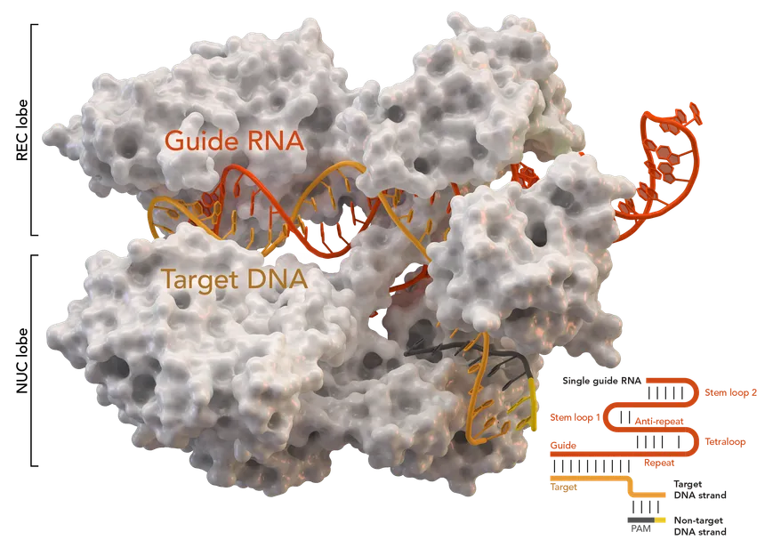
Notes:
This is the Cas9 protein.
Cas9 is a type of CRISPR-associated protein
Cas9 can be programmed with a small RNA molecule to guide it to the specific DNA sequence, where it cuts the DNA
So Cas9 essentially acts as molecular scissors.
Because of this it has been Adapted as a genome editing tool

Slide 5
The Problem with CRISPR Visualization and Analysis
Comprehensive Tools
Investigate loci and sequences of DRs and spacers
Existing tools: CRT, PILER-CR, CRISPRFinder, etc.
Limitations of Current Tools:
Lack interactive and user-friendly visualization
Complexity and non-interactivity of Excel macros
Over-reliance on specific detection tools
Confusing visual outputs with complex datasets
Gap in the market
Need for an all-in-one tool to visualize, manipulate, and analyze CRISPR arrays effectively
Notes:
There is a need for tools to help visualize sequences of direct repeats and spacers. And there are Tools, such as CrisprStudio and CRISPRFinder that help to provide clear and intuitive visualizations of CRISPR sequences.
However the researchers note that these tools lack interactivity and tend to be not user friendly and complex. And limited in visualization. For example, CRISPRStudio only present spacers graphically.
The researchers recognize a need for an all-in-one tool to visualize, manipulate, and analyze CRISPR arrays effectively.

Slide 6

Why use Python?
Extensive Bioinformatics libraries
Biopython: sequence analysis and data manipulation
Pandas: efficient data handling and analysis
Matplotlib & Seaborn: powerful data visualization tools
Seamless integration with existing bioinformatics tools
Large, active community
Capable of handling large datasets efficiently
Notes:
They chose to use python to develop their tool because of its extensive bioinformatics libraries, eas of use and seamless integration with current tools.

Slide 7





Python Libraries Used
Biopython: sequence analysis and manipulation
Pandas: efficient data organization and management
NumPy: handling large datasets
Matplotlib: creating visuals
Seaborn: high-level statistical graphics
Notes:
In their development, they implemented pandas and numpy for data processing and computation
While the matplotlib and seaborn packages are used to visualize results along with Biopython for sequence analysis and manipulation.

Slide 8
Results
Notes:
The researchers were able to successfully develop a python package with a graphical user interface with various functionalities to manipulate and interpret CRISPR data.
CrisprVi is a flexible package that allows various CRISPR finding methods such as CRISPRCasFinder, MinCED, and others. This allows the user to use any CRISPR finding method and even use multiple methods to compare the prediciton accuracy between the tools.

Slide 9
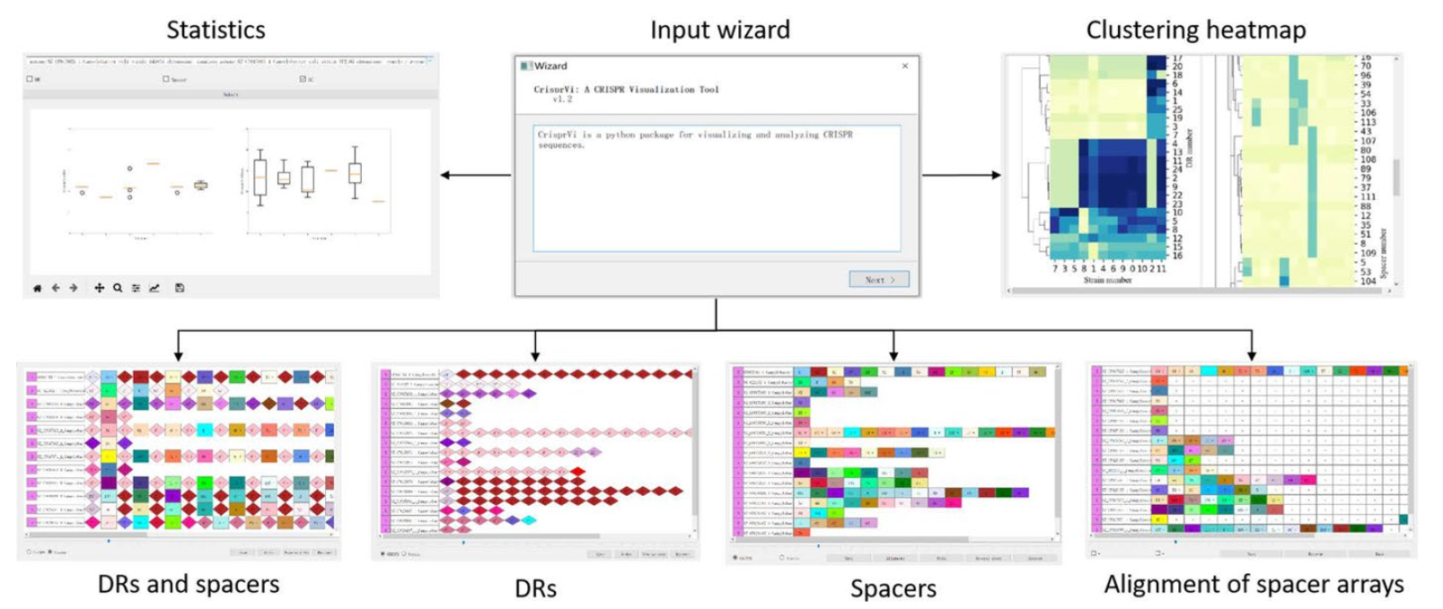
GUI Overview
Notes:
The researchers were able to successfully develop a python package with a graphical user interface with various functionalities to manipulate and interpret CRISPR data.

Slide 10
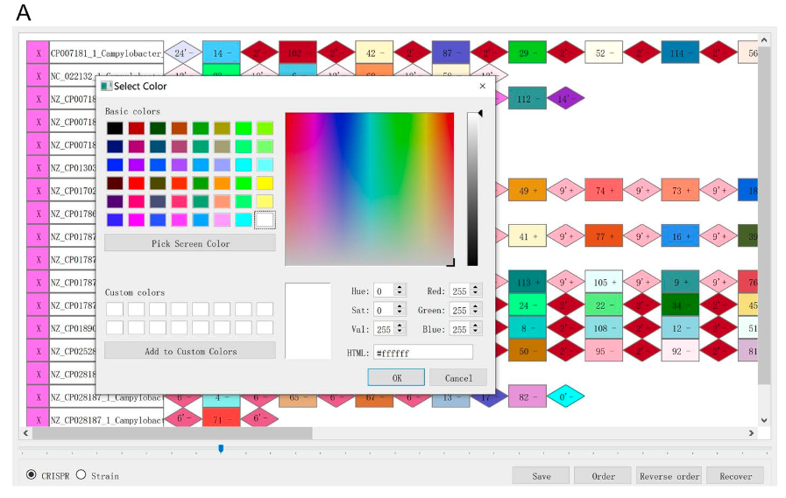
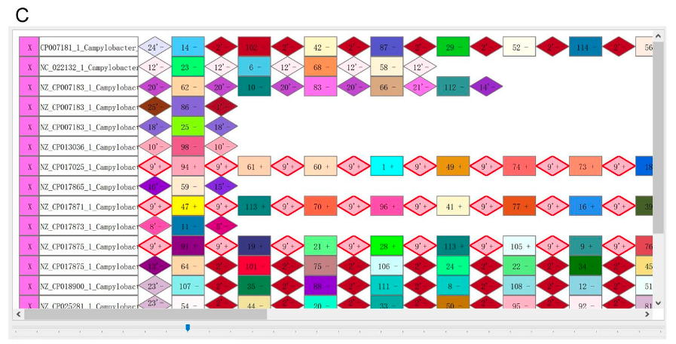
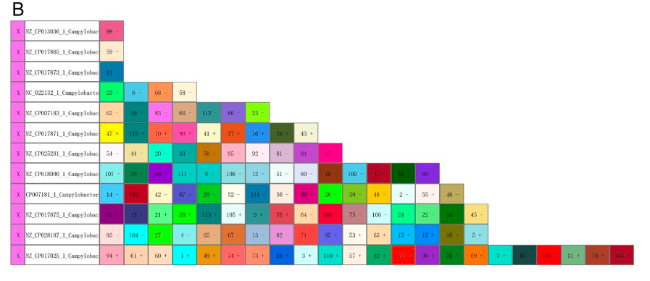
User can customize graphics for DRs/spacers
Notes:
User is able to change graphic color manually, sort spacer arrays by length and even highlight identical CRISPRs by red borders.
Visualized CRISPRs of 12 C. Coli strains which where predicted by CRISPRCasFinder

Slide 11
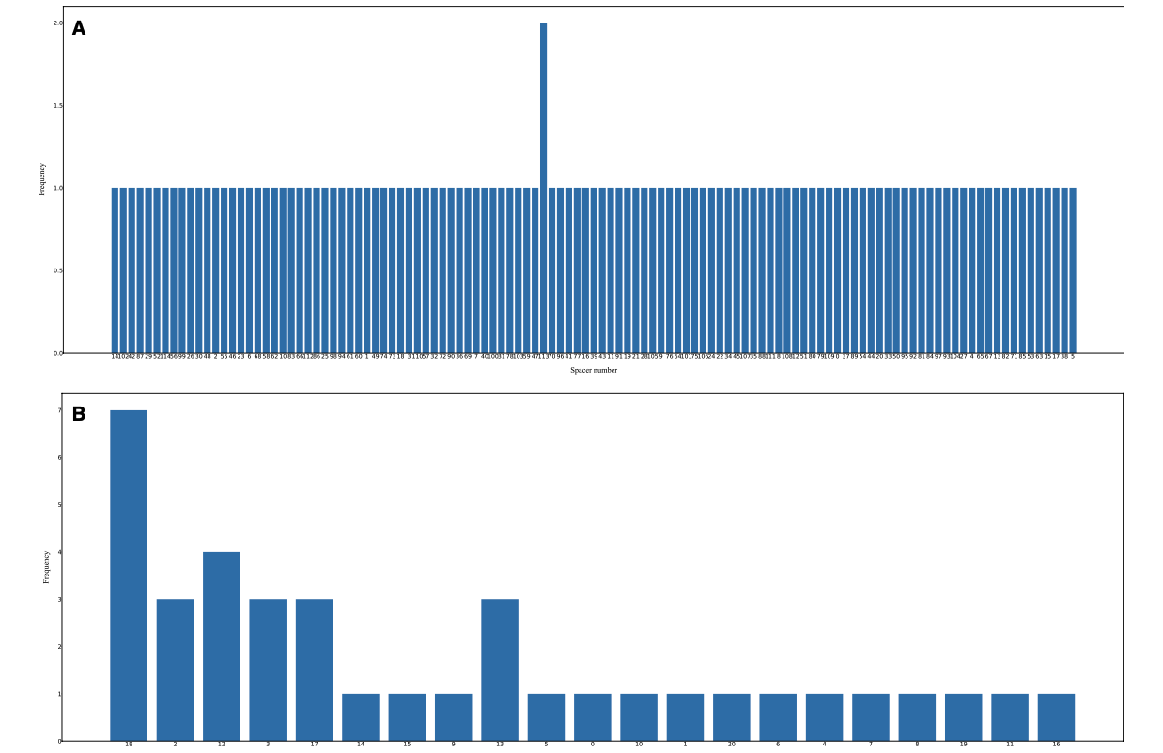
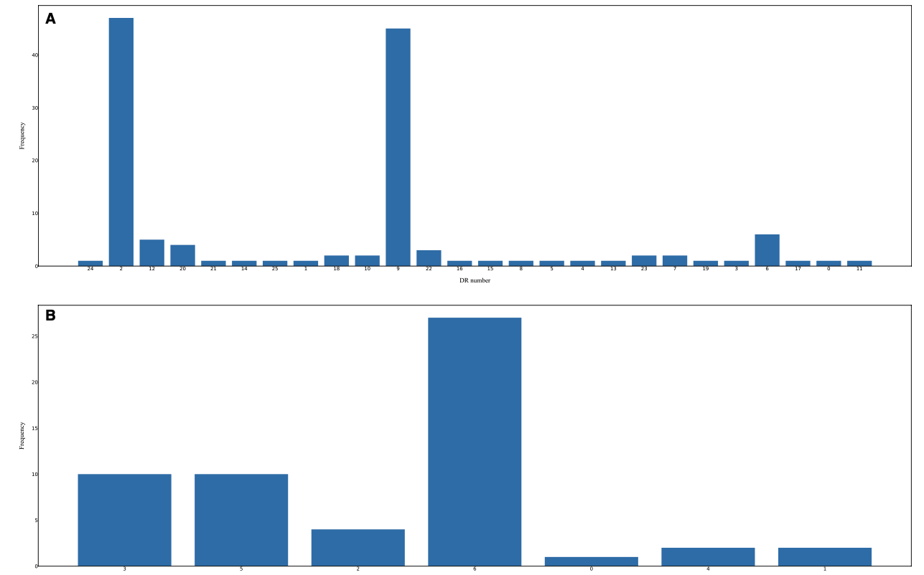
Perform statistical analysis of the DRs/spacers on selected strains
Notes:
With CrisprVi, users can generate histograms for direct repeats seen here in the picture which is figure 4 in the article(click for next image)
Similarly, the Spacer count across strains can be calculated and visualized in histograms as well
Users can inspect details of the plots using commands in the menu.

Slide 12
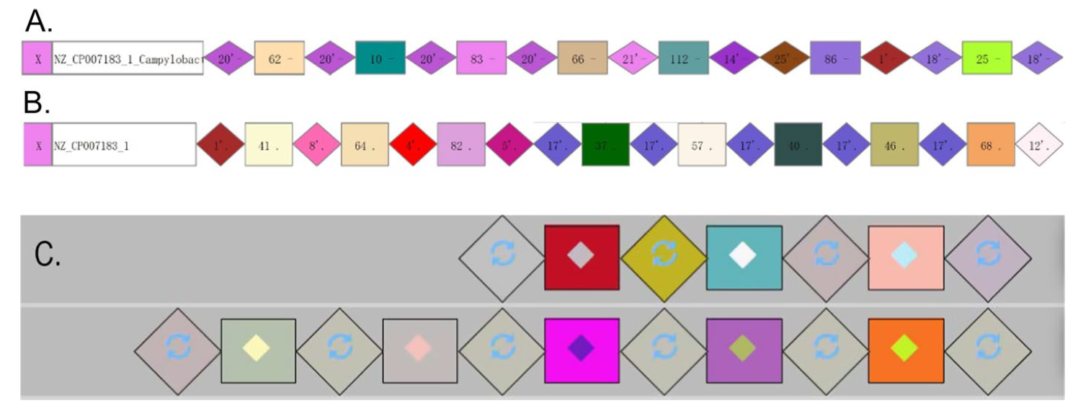
More Detailed Visualization
Notes:
Compared to other tools such as CrisprViz which is labeled C in the image, CrisprVi which is labeled A and B in the image is more flexible and provides more detailed visualization.

Slide 13
My Thoughts
Feature | CrisprVi | CRISPRviz | CRISPRStudio
Visualization of DRs and Spacers | Yes | Yes | No (Only Spacers)
Customization | Yes | Limited | No
Interactive GUI | Yes | Yes | No
Statistical Analysis Tools | Yes | No | No
Accepts outputs from various CRISPR Finding tools | Yes | No (MinCED only) | No
Flexibility in CRISPR detection methods | Yes | No | No
Ability to change visualization settings | Yes | No | No
Efficiency (Data Loading Speed) | Moderate | Fast | N/A
Notes:
I feel that CrisprVi is a very innovative tool addressing a significant gap in visualization and analysis of Crispr sequences. CrisprVi is more flexible and interactive and offers a more user friendly interface making it easier to navigate and customize. For students and researchers, CrisprVi offers a practical way to learn about Crispr sequences through manipulation and visulization for analyzing and interpreting CRISPR data.

Slide 14
References
Biopython. (n.d.). Biopython logo. Retrieved from https://biopython.org/wiki/logo
Jia, B., Zhang, X., Jiang, Q., Wang, Z., Zhang, Y., Hu, Y., & Wang, Y. (2022). CrisprVi: a software for visulaizing and analyzing CRISPR sequences of prokaryotes. BMC Bioinformatics, 23(1), 257. https://doi.org/10.1186/s12859-022-04716-9
Matplotlib developers. (n.d.). Matplotlib logo. Retrieved from https://matplotlib.org/stable/gallery/misc/logos2.html
NumPy developers. (n.d.). NumPy logo. Retrieved from https://github/com/numpy/numpy/tree/main/branding/logo
pandas development team. (n.d.). Pandas logo. Retrieved from https://pandas.pydata.org/about/citing.html
Python Software Foundation. (n.d.). Python logo. Retrieved from https://www.python.org/community/logos/
Seaborn developers. (n.d.). Seaborn logo. Retrieved from https://seaborn.pydata.org/citing.html
Splettstoesser, T. (n.d.). Cas9 protein structure [Image]. Wikimedia Commons. Retrieved from https://en.wikipedia.org/wiki/Cas9#/media/File:Cas9_5AXW.png

Slide 15
Questions?

